Slide 1




Smart
Nyuki
Empowering Beekeepers with Data-driven insights.
BEE SMART, FARM SMART!

Slide 2










Meet the Team
Dr. Lawrence Nderu
Project Investigator
Brian Rop
IoT Engineer
Charles Mwangi
Front-end Developer
Methusella Nyongesa
Back-end Developer
Gerald Njamura
UI/UX Developer
James Karanja
IoT Engineer
Maina Chrispin
Back-end Developer
Shem Thuo
Front-end Developer

Slide 3

“If the bee disappeared off the surface of the globe, then man would only have four years of life left. No more bees, no more pollination, no more plants, no more animals, no more man.”
Albert Einstein
Smart Beekeeping enhances bee health and colony populations and reduces bee mortality, making earth a bee-safe place.

Slide 4
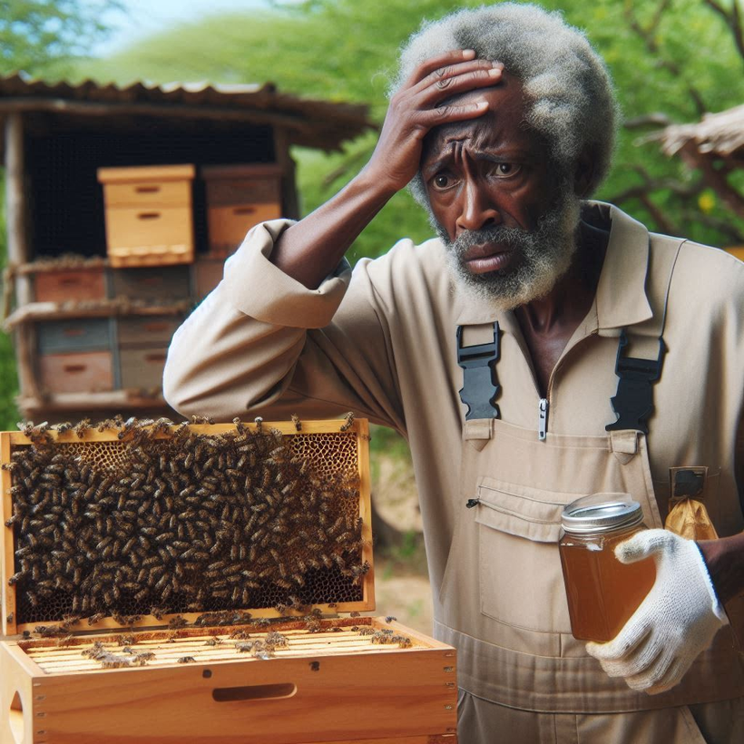
The Silent struggle of Bees
A look into reasons why the sector is in need of a change in the form of a smart solution.

Slide 5
The Silent struggle of Bees
Present loopholes in Traditional Beekeeping
Inconsistent Honey Production through estimation of harvesting times
Disturbance of Bee Activity through unnecessary inspections
Lack of Real-Time Data to detect critical changes in hives

Slide 6
The Silent struggle of Bees
Present loopholes in Traditional Beekeeping
Unsustainable Practices which may not support the long-term health of bee populations
Delayed Response to threats
Unprecedented Swarming

Slide 7


Solution
Smart Nyuki leverages use of IoT sensors and data analytics
to gather data and monitor metrics such as temperature, humidity, sound and weight which would be used to give insight on the bee activity inside the hive.
Bee Smart!

Slide 8



Solution
Remote Monitoring
Real-time Monitoring
Bee-Alert notifications

Slide 9



Solution
Data-driven harvesting precision
Non-intrusive hive management
Environmental and Ecological benefits

Slide 10







How SmartNyuki Works
Cloud
Hive 1
Gateway
Farmer’s mobile device
Hive 2

Slide 11



Target Market
Increasing number of Kenyan farmers and hobbysts estimated to be 90,340
Businesses that sell hives to farmers - Yatta Beekeepers
Conservation organizations dealing with apiculture
2 M
estimated hives in Kenya
4.2%
annual growth rate of the sector

Slide 12

Monetization
Subscription Model
Standard Plan and Premium plan
Equipment Sales
Sensors, communication devices, integration tools
Data Analytics Service
Customer reports, Predictive modelling
Consulting and Training
On-site workshops, Consultative training, Educational resources

Slide 13
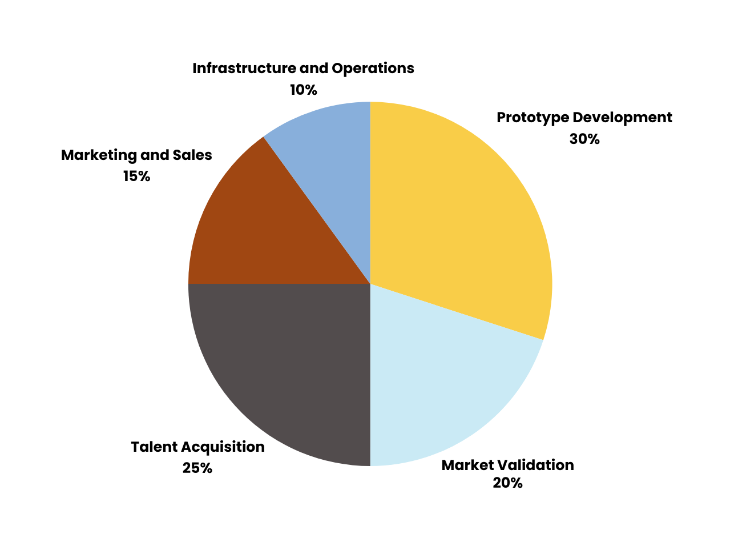
Capital Utilization

Slide 14

Potential Investors
Non- Governmental Organizations & For-Profit Organizations
Financial Institutions & Impact investors in sustainable agriculture
Conservation Organizations

Slide 15


Thank You
For Listening

